Slide 1
Process Journal and Design Thinking

Slide 2
Process Journal
You are required to maintain a process journal, which should be updated regularly during the development of the investigation with 10-15 individual entries, and should be used to record progress honestly.
Includes: thoughts, ideas, decisions, reactions, successes and failures.
Can also include photographs, screen shots and other visual representations of the steps of your work (based on the type of project you have chosen to do).

Slide 3
If you use/refer to any sources in your journal entry, include a citation & annotation at the end of the entry (MLA 8 style)
The process Journal will be recorded on ManageBac and backed up on a word document or written journal.
Used in discussions with supervisors and to record these discussions. This will also help you to write your written report.

Slide 4
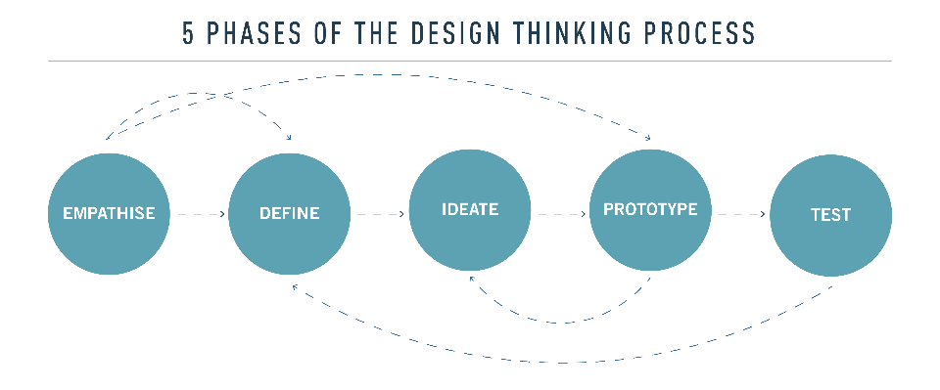
Design Thinking Cycle

Slide 5
EMPATHISE
This should be included in your first Process Journal Entry
Empathizing in Passion Project constitutes of writing down ideas about something you are passionate about and care for

Slide 6
DEFINE
The next stage is to define a clear goal
Make a SMART goal
The process of making a SMART goal should be reflected in the journal as your second entry
Think of questions like:
What do I want to achieve?
What is the main issue of concern in achieving my goal?
Whether my goal is SMART?
Is my goal doable?

Slide 7
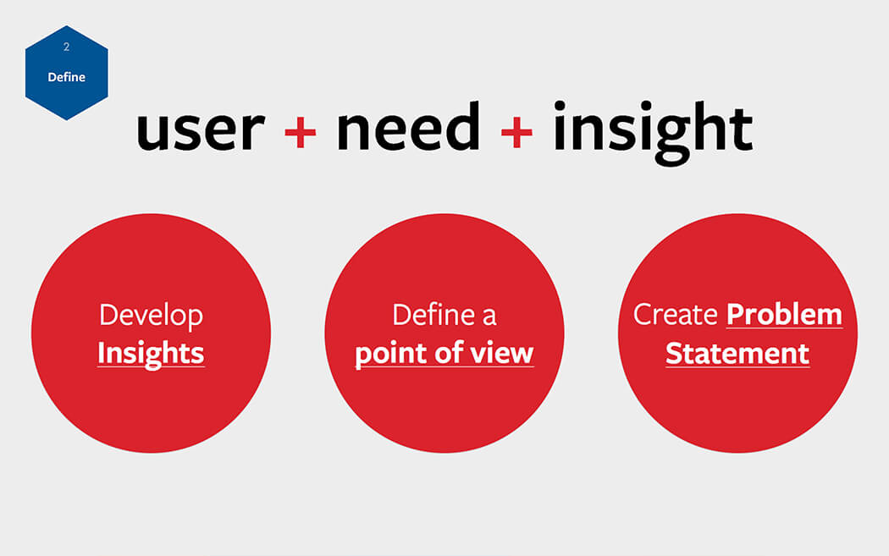

Slide 8
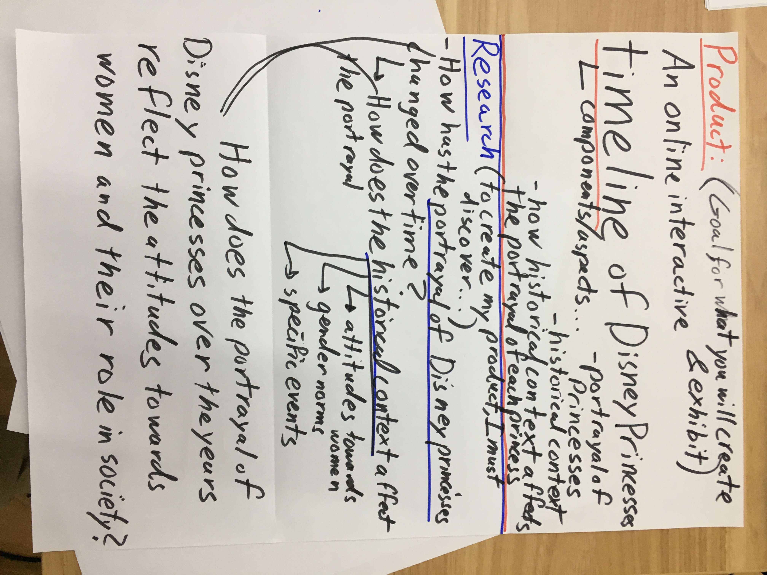
An example: You can upload picture of notes you have made

Slide 9
IDEATE
You can make journal entries which show ideation based on your research process
For Example:
Create a question tree
(you have learnt this in critical thinking)
Upload graphic analysis of research findings
Record the process of how you found sources for research (eg. Effective use of keywords)
Record any analysis of sources and perspectives that proves to be relevant for your research

Slide 10
1st Tier
Your Assigned Question
More
Open
General
?
?
?
?
2nd Tier
?
?
?
?
?
?
?
?
?
?
?
?
?
?
More Closed Specific
3rd Tier

Slide 11
Repeat: Fill in the gaps until you have enough questions
1st Tier
How can we deal with global warming?
What are the human factors?
What are the geological factors?
How does global warming work?
What are the impacts of global warming?
2nd Tier
What political forces impact global warming?
What caused climate shifts in the past?
What causes the greenhouse effect?
What were the results of past climate shifts?
What Role does the Ozone Layer Play?
What personal behaviors contribute to global warming?
What natural processes create greenhouse gasses?
What will happen to the weather?
Are all Greenhouses gasses equally damaging?
3rd
Tier
What industries create greenhouse gasses?
What will happen to coastal cities?
Does the earth’s climate change on its own?

Slide 12
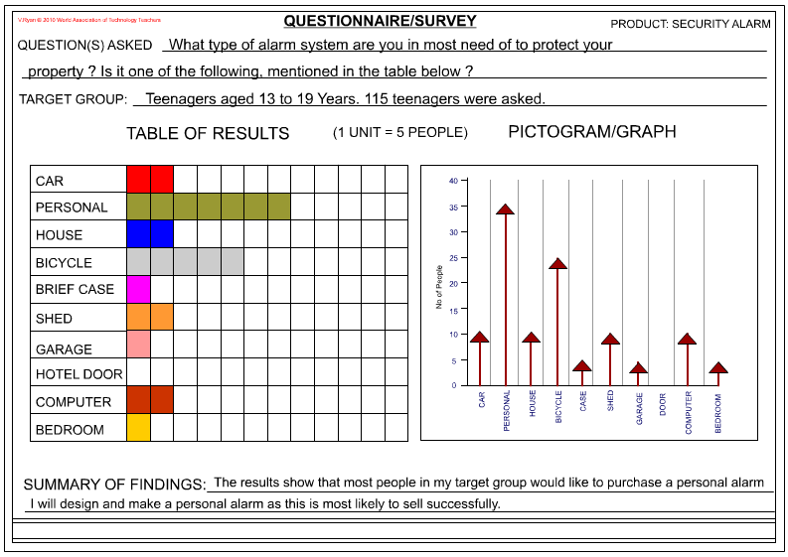
You can also make entries of your other research processes
Also record events and interactions which made you think differently
Example: Upload a survey questionnaire and its analysis in the form of a graph. Also mention any significant inferences you made which challenged your own ideas
Source: http://www.technologystudent.com/designpro/quest1.htm

Slide 13
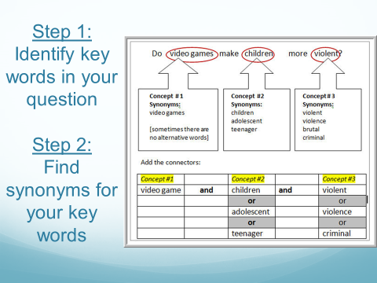
Critical thinking and steps towards research

Slide 14
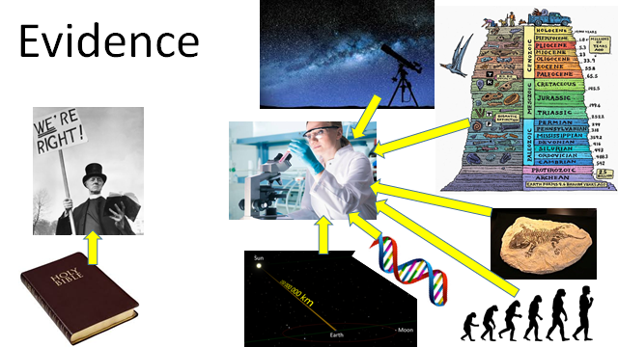
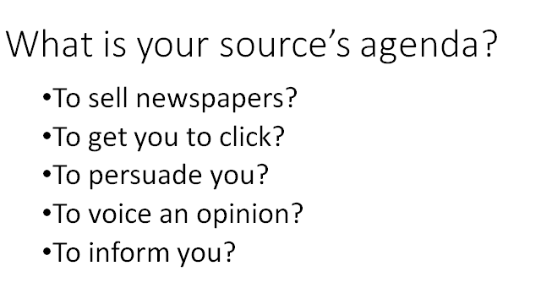
Questioning sources and Process Journal History
Apply critical thinking skills to sources you come across for your research
Analyze the usefulness and limitations of your sources

Slide 15
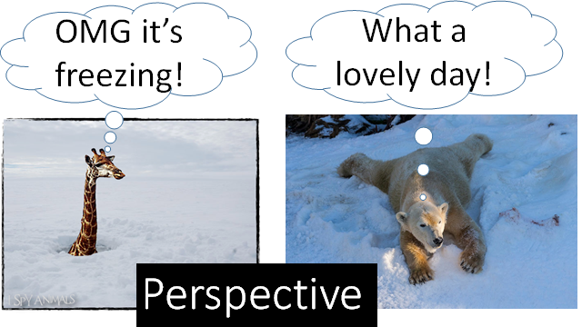
Identify perspectives in sources and record your observations in process journal

Slide 16
PROTOTYPE
Prototyping is getting ideas and explorations out of your head and into the physical world
It can be it a wall of post-it notes, a role-playing activity, a space, an object, a model, an interface, or even a storyboard
This can be reflected through picture of your possible product, graphic results of your research etc.

Slide 17
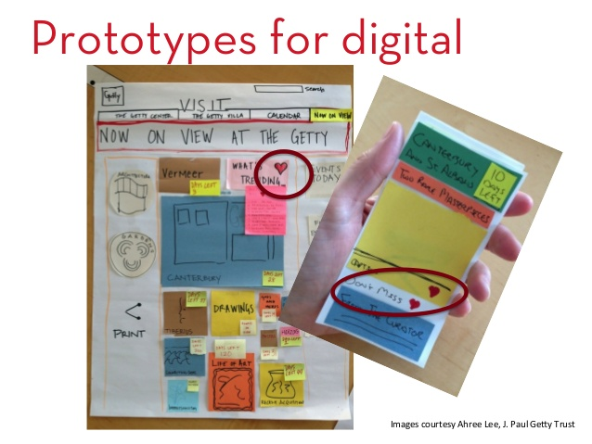
A prototype of a digital platform
Source: https://www.slideshare.net/dmitroff/design-thinking-at-museum-next-2014-for-slideshare

Slide 18
TEST
Testing is the chance to get feedback on your solutions, refine solutions to make them better, and continue to learn about your users
Remember that your product should be of some use to others
It is important to receive feedback from possible targets of your product and include the findings in the Process Journal

Slide 19
PP Final Project Proposal
Deadline for uploading PP Final Proposal:
7th December

